Slide 1
Bedouins
By Tanishka Maurya

Slide 2
Who are the Bedouins?
Bedouins are Arabs and desert nomads who hail from and continue to live primarily in the Arabian peninsula, the Middle East and North Africa.
Bedouins are the oldest inhabitants of the deserts of Arabia.
Bedouin society is tribal and patriarchal.

Slide 3
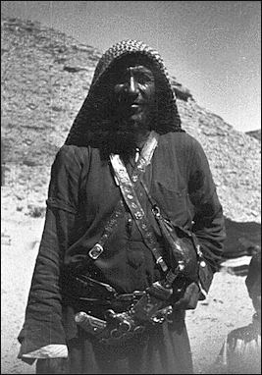
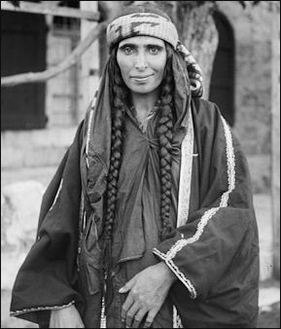
Source - factsanddetails.com

Slide 4
Culture and Traditions
The Bedouin are an extremely proud race, and follow a strong code of honor. They are known for their loyalty, first to their immediate families, then their clans and tribes.
Each member of the household would contribute to family life.
They are also known for their hospitality and welcoming nature. Guests would be greeted with utmost respect, and likely to be welcomed with food, dates and coffee.

Slide 5
Camels were integral to their survival. They were a mode of transport, a source of nourishment, and a symbol of wealth. Camel hide would be used to make tents, shoes and warm clothing (necessary in the colder winter months), while camel hair would be woven into rugs.
Falconry is another tradition steeped in Bedouin history.

Slide 6
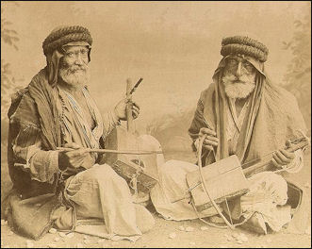
Source - factsanddetails.com

Slide 7
Religious Beliefs
The vast majority of Bedouins are Sunni Muslims.
The Bedouin societies throughout the region variously believe in the presence of spirits, some playful and others malevolent, that interfere in the life of humans.
The envious eye is also very real to the Bedouin, and children are believed to be particularly vulnerable. For this reason, they often have protective amulets attached to their clothing or hung around their necks.

Slide 8
Ceremonies and Rituals
Bedouin ceremonies and rituals include elaborate celebrations of weddings, ritual naming of newborn infants, and the circumcision of children.
They celebrate the Prophet's birthday and carry out pilgrimages to the tombs of saints.
Hospitality is extensively ritualized.
Whenever an animal is slaughtered for a guest, men ritually sacrifice it in accordance with Islamic law.

Slide 9
Contemporary Times
While many Bedouins have abandoned their nomadic and tribal traditions for modern urban lifestyle, they retain traditional Bedouin culture with concepts of belonging to traditional music, poetry, dances and many other cultural practices.
Urbanized Bedouins also organize cultural festivals, usually held several times a year, in which they gather with other Bedouins to partake in various Bedouin traditions. Traditions like camel riding and camping in the deserts are also popular leisure activities for urbanized Bedouins who live within close proximity to deserts or other wilderness areas.

Slide 10
The Gradual Process of Sedentarization of the Bedouins
The Arab tribes spread throughout the Middle East during the early Muslim expansion in the 7th century.
In the following centuries the Bedouin nomadic tribes existed side by side with other ethno-religious groups and interacted with the various regimes that controlled the region.
These tribes had varying traditions with regard to land rights.

Slide 11
Although these tribal territories often overlapped and were contested, the tribes themselves had a very keen understanding of the boundaries, usually defined by natural and manmade landmarks.
The Bedouins competed for land and resources with city dwellers and peasants. Until the mid to late 19th century, the Bedouins frequently had the upper hand in these dealings and were able to extort money from both the Ottoman administration and the peasants.
The Ottomans began to react to this state of affairs only in the second half of the 19th century, with military expeditions against the Bedouins.
Reflecting an attempt by the state to extend its control outside the cities, the Ottoman Land Code led to a change in ownership of village lands.

Slide 12
The military was the primary tool used until the 1890s when ‘the government began to use sophisticated means in order to secure control and encourage the integration of the Bedouin element in the empire.’
The application of the Ottoman land laws and the creation of Sultan Abdul Hamid II’s private estates contributed to the extension of government control to areas of state lands, traditionally controlled, but not owned by Bedouins. In some places this resulted in sedentarization.
In Egypt the ascent to power of Mohammed Ali Pasha freed the country from Ottoman rule and opened it to European influence.
Mohammed Ali and his successors nationalized all the desert land of Egypt, while agricultural land was privatized and purchased by investors and farmers. This policy led to the exclusion of the Bedouins from the land they had lived on for generations.

Slide 13
The growth of modern states in the Middle East greatly impinged upon Bedouins’ traditional ways of life. Following World War I, Bedouin tribes had to submit to the control of the governments of the countries in which their wandering areas lay.
In the second half of the 20th century, Bedouins faced new pressures to abandon nomadism.
Some other Bedouin groups settled voluntarily in response to changing political and economic conditions.
The process of transformation from nomadic pastoralism to sedentary production has been either prolonged or brief depending on the particular circumstances of the nomadic group's settlement.

Slide 14
By and large the reasons behind the burst of change and transformation have been economical:
The first set of factors included a series of droughts in the 1950s and the 1960s which rendered many Saudi nomadic groups impoverished of their economic resources (grazing lands and animals herds), as well as major changes in their relationship to the land resource (through land reforms).
The second set of factors included changes in the regional economic setting, which opened many other work possibilities (largely unskilled) to the Bedouin groups, as well as various efforts by the Saudi government to incorporate the impoverished nomadic groups into peasant agriculture.

Slide 15
Conclusion
The sedentarization of the Bedouins and the extension of state control to areas in which they traditionally resided has been the result of the extension of laws to these regions.
The period from 1858 to the present has therefore seen the increasing exertion of the power of the state, initially with the 1858 land law and the reign of Sultan Abdul Hamid II, and later with the introduction of colonial law and administration.
The period of independent statehood has seen differences in Bedouin-state relations with a general trend towards complete sedentarization of the Bedouin.

Slide 16
Thank You

